Slide 1

Market Tide
Current Events Changing World Markets

Slide 2

Market Tide (mär-kət \ ˈtīd) metaphor: broad trends that are governed by large, macro forces outside the control of any one single investor, company or even economy.

Slide 3

Elevator Pitch with Max

Slide 4
Concept
During any ongoing crisis,
Market Tide will track, analysis and award financial information relevant to the calamity of the global stock exchange.
Assess, Present, Evolve

Slide 5
Motivation
Third Party APIs
CSS framework
Experience
Challenge
Team
Work

Slide 6
User story
Given I am interest in the stock market
When I open the Market Tide webpage
Then I am given a choice between stock market, currency and country
When I select a country
Then stock Market and corona Tabs will populate
When I mouse over the graphs
Then I will be given information regarding the selected field

Slide 7
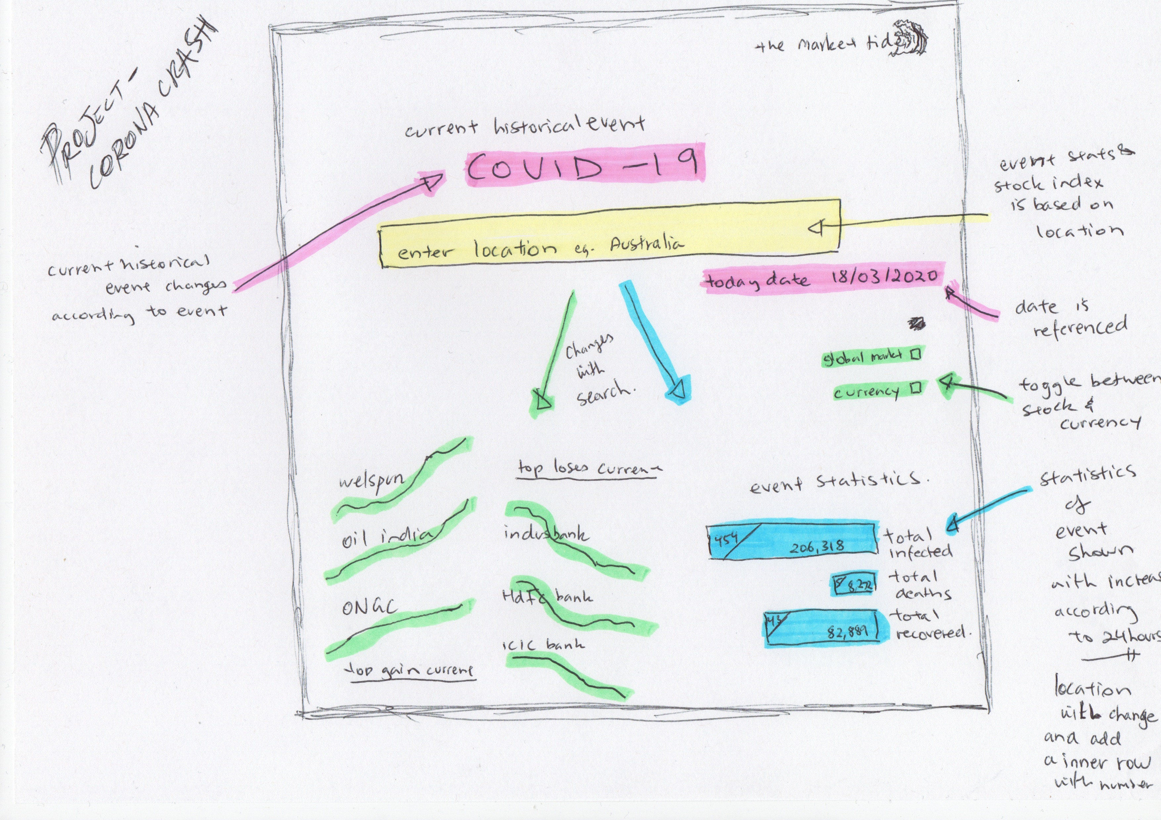
Original wireframe

Slide 8
Process
FIRST PARTY GITHUB, ECHART, BULMA, GITKRAKEN, VS CODE
THIRD PARTY ALPHAVANTAGE, IEXCLOUD, FINNHUB, WORLD TRADING, YAHOO FINANCE

Slide 9
Challenges
Sourcing an API for dealing with stock markets outside of the US (AUS specifically)
Rate limits and quotas on API's - could be overcome with paid licenses (more investment)
Teamwork via video link posed a challenge
Learning the limits of API database
Using EchartsJS then Charts.Js
Time allocation

Slide 10

Success
charts.js and Bulma accessibility
idea felt original

Slide 11
MARKET TIDE DEMONSTRATION

Slide 12
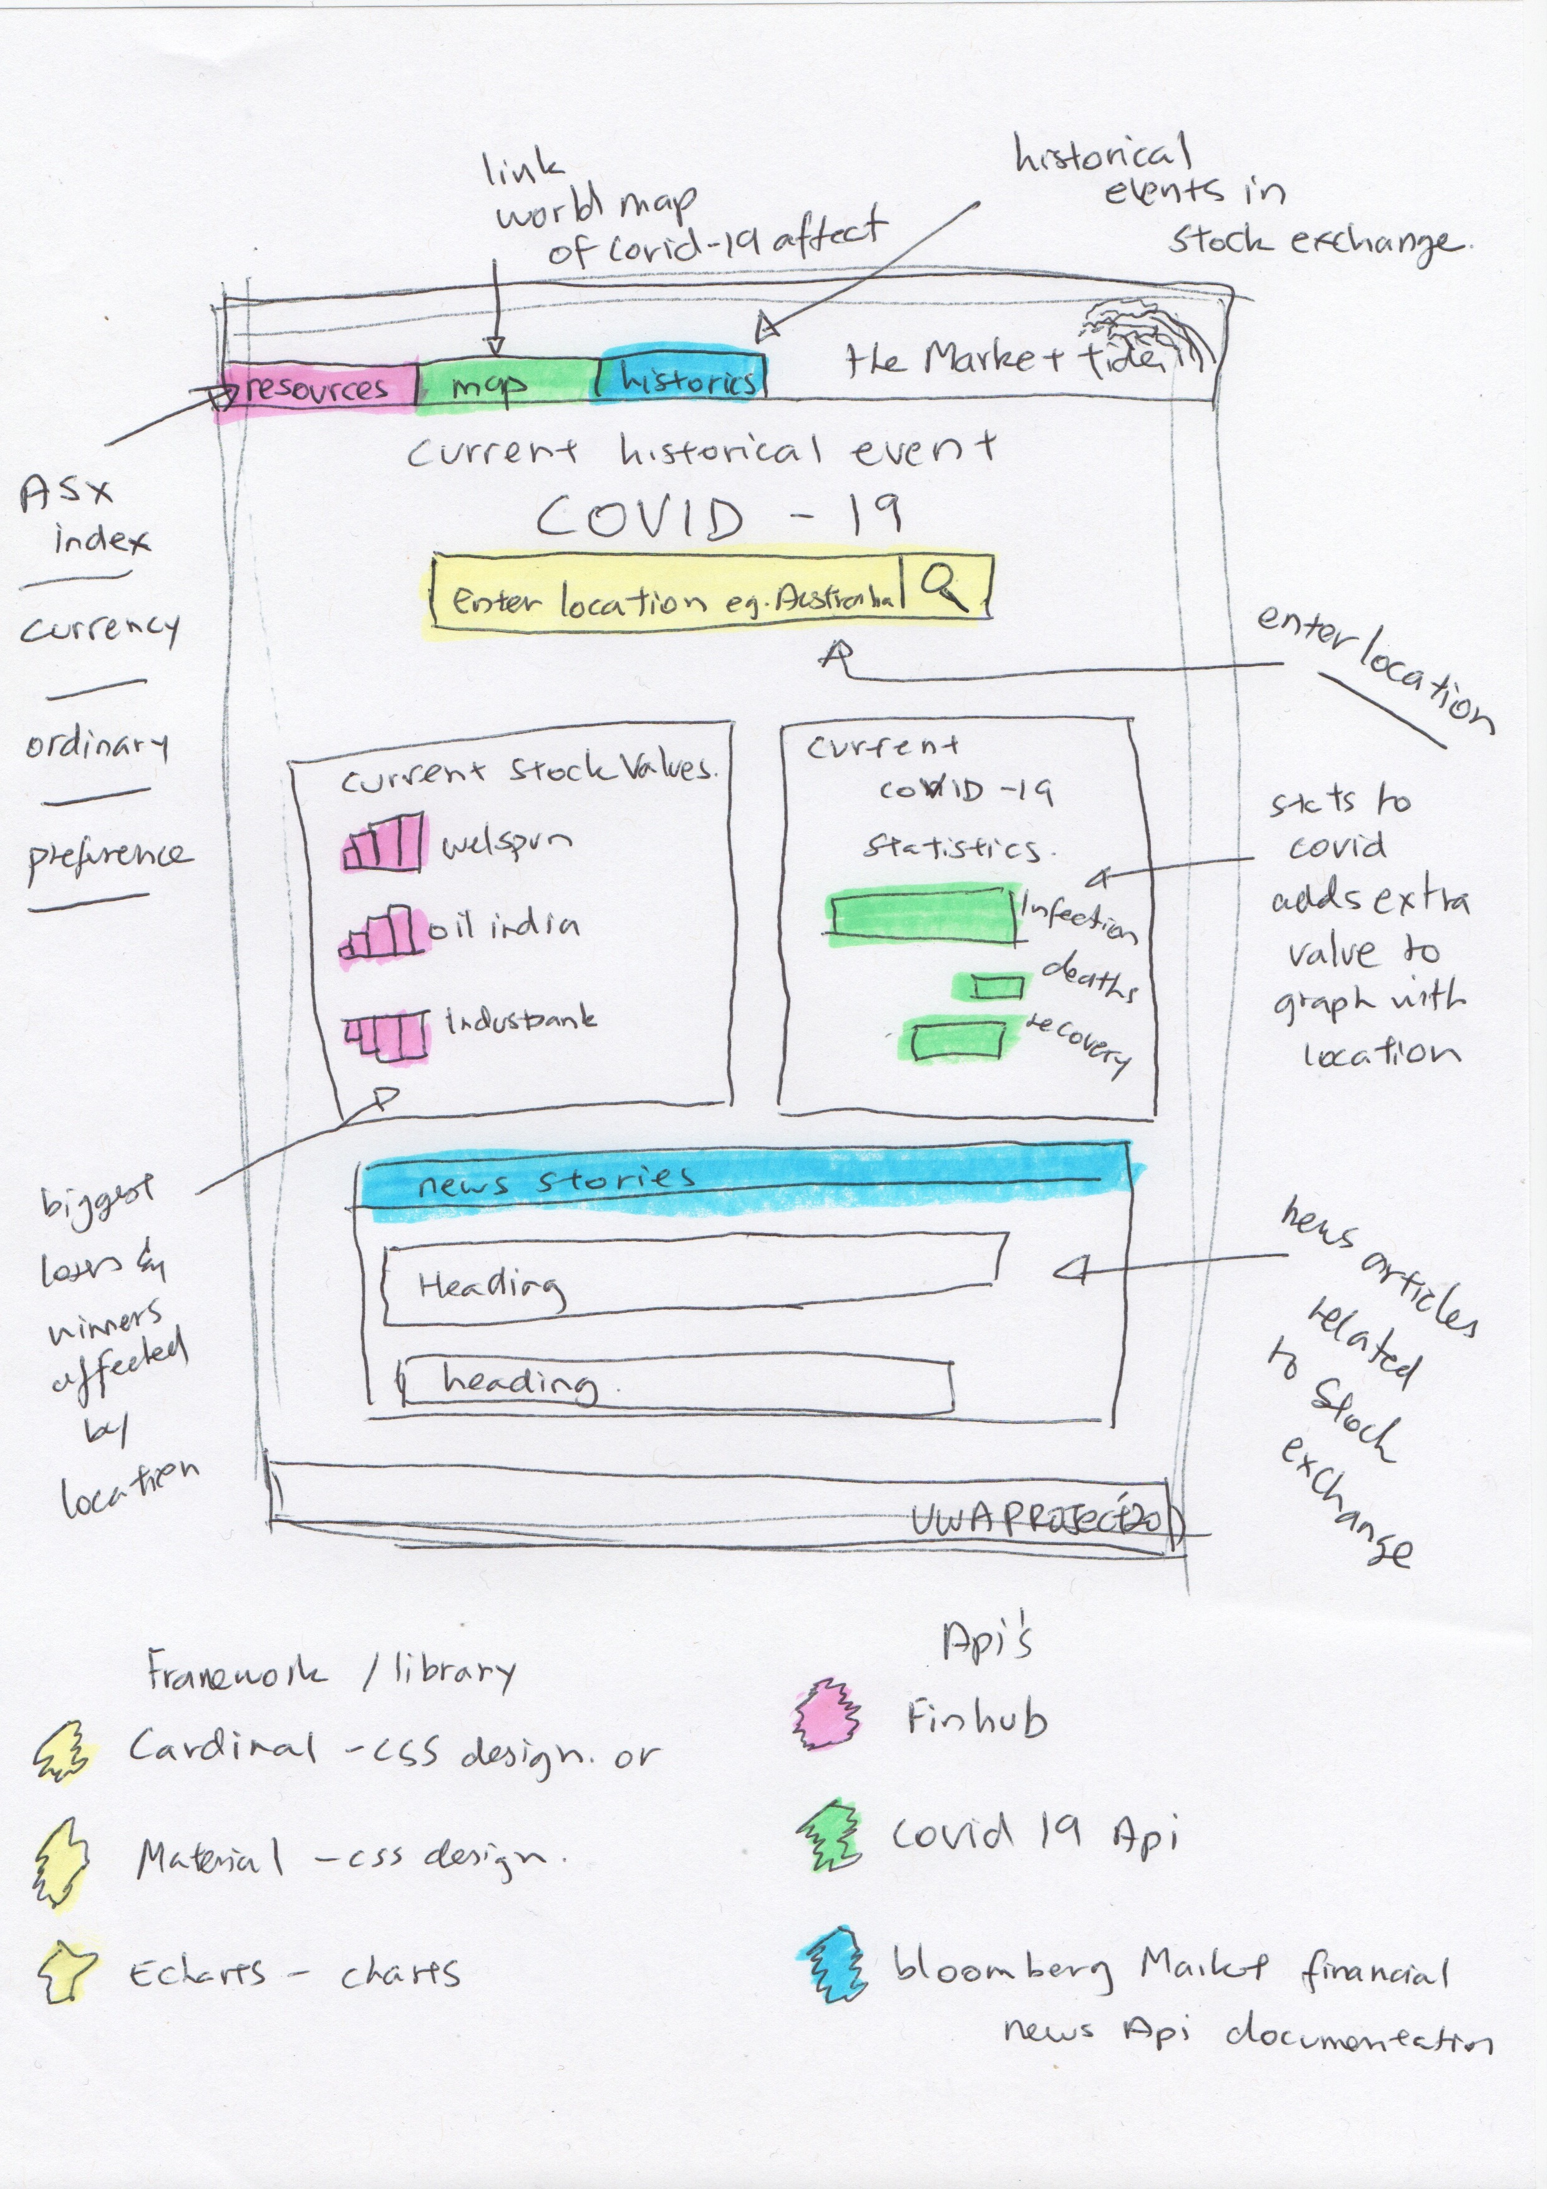
Future Development
Stage 1
Build the database for the different countries stock markets
Fix the framework to be responsive and accessible
Stage 2
Add in a navbar with links to additional information regarding Stock, disaster and the connected history
Add a News Article section at the bottom of the page
Make the Global Historical Event interchangeable e.g. 9/11, political etc

Slide 13
Links
https://github.com/maxtsimpson/coronaCrash

